Slide 1
Engineering 3-2 Programs 3 years at one school 2 years at an engineering school Dual Degree in Physics and Engineering
At Stout you can do the same thing in five years without having to change schools
Notes:
What is your dream job? Where do you want to work?
How many of you know what kind of job you want when you graduate?
How many of you know you want to work outside of Wisconsin?
How many of you have friends and family here and absolutely want to stay in Wisconsin?
How are you going to make yourself stand out in the crowd of new engineers?
In 2015 there were 106,658 new bachelors degrees in engineering. About a quarter of those were mechanical engineers
. How are you going to stand out in a crowd?

Slide 2
Jobs for Bachelor’s Degrees in Physics (without engineering degree!)
Mechanical Engineer
Electrical Engineer
Optical Engineer
Laser Engineer
Systems Engineer
Process Engineer
Design Engineer
Software Engineer
Software Developer
Programmer
Analyst
And many more
Imagine what someone with a double-degree could accomplish!
Notes:
A sample of job titles from a 2015 survey of undergraduate physics majors after graduation
A physicist is someone who can use quantitative reasoning and create models to solve a variety of problems.
(without an engineering degree. Think what you could do with a physics degree AND an engineering degree!)
There are almost no jobs with the title “Physicist”
Physicists are generalists while engineers are specialists.
Related but different skill-set.

Slide 3
Physics at UW-Stout
ASAP-ME:
Applied Science: Applied Physics and Mechanical Engineering Double Major
Additional Courses:
Intro to Physics Research
Intro to Quantum Mechanics
Computational Classical Physics
Solid State Physics
Applied Optics and Photonics
Advanced Physics Lab
Quantum Mechanics
Applied Electromagnetics
Computer Science I and II
Scan QR Code to see flowchart
Contact Prof. Zimmerman for more information:
zimmermant@uwstout.edu
Lasers, Optics, Plasmas, Computational Modeling, and Quantum Computers

Slide 4
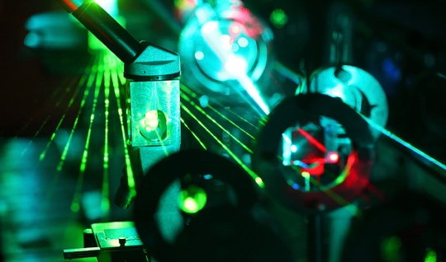
Physics Minor
Statics and Dynamics or University Physics I
University Physics II
11 credits from the following:
PHYS-139 Intro to Research
CEE-355 Applied E&M
Any PHYS-3XX
Thermodynamics (PHYS-222 or ENGR-275 or ME-390)
Classes in bold are ones you take for your major
Contact Prof. Sinkovits for information: sinkovitsd@uwstout.edu
Notes:
CEE-355 also counts

Slide 5

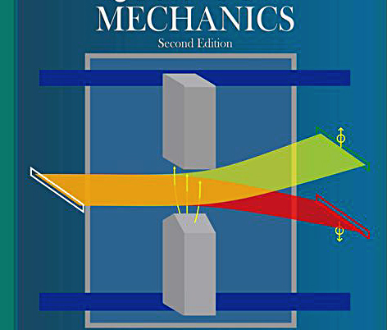
Quantum Mechanics
PHYS-413 MWF 8:00 am – 8:55 am
Tech elective
Prereq: PHYS-313
Learn more about the weird world of atoms, photons, and molecules:
Quantum mechanical spin ½ particles, Dirac notation, quantum entanglement, quantum teleportation, quantum computing

Slide 6
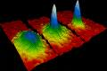


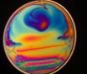
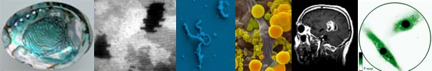
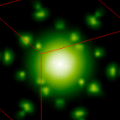
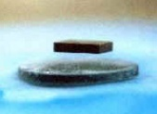
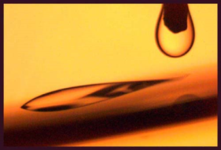
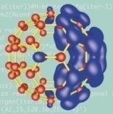
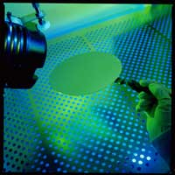
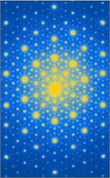

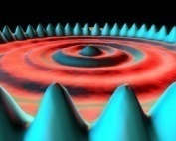
Enroll for Spring ’23! Solid State physics
Required for Applied Physics majors and Physics Minors.
Offered every other Spring. Take it now!
Take it as a TECH Elective!
Apply it toward a materials minor!
the stuff of life
PHYS 427-001
MWF 2:30 – 3:25 PM

Slide 7
Upcoming Courses
Summer 2023
University Physics II (PHYS-282)
Fall 2023
Applied Optics and Photonics(PHYS-335)
Spring 2024
Intro to Research Methods in Physics(PHYS-139)
Advanced Physics Lab (PHYS-439)

